Slide 1







Altair Data Science Hackathon
Name : Byleen Janet Roy
Topic : Diabetes classification
College : Loyola ICAM College of Engineering and Technology

Slide 2










1.Design Motivation
What did our design process look like?

Slide 3
Motivation
Early Detection: Enables timely intervention for diabetes management and prevention.
Increased Accuracy: Improves diagnostic accuracy compared to traditional methods.
Efficiency: Provides faster diagnosis, saving time for healthcare providers and patients.
Scalability: Can be easily integrated into various healthcare settings.
Cost-Effective: Reduces the costs associated with misdiagnosis and delayed treatment.
‹#›

Slide 4

2. Design Description
What is the ﬁnal design?

Slide 5
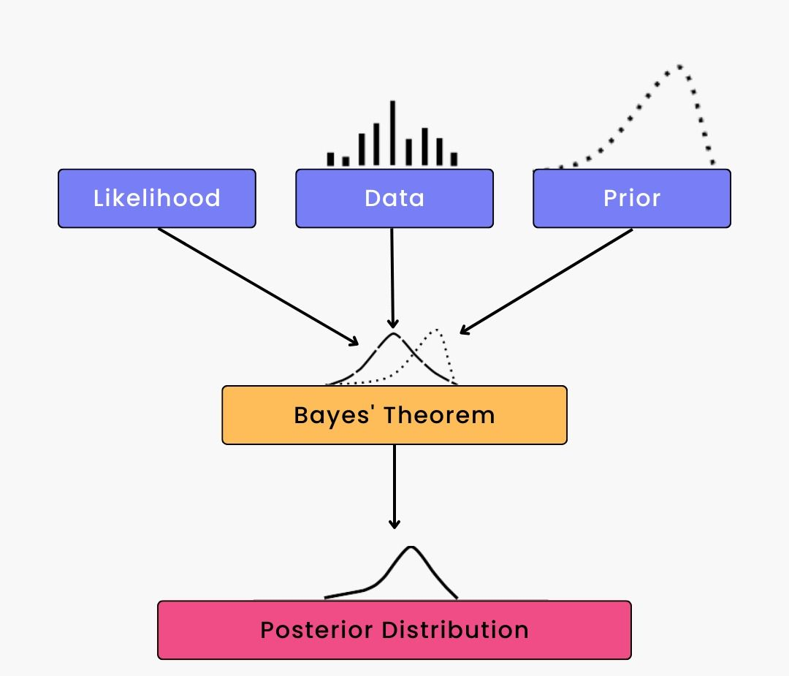
Design Description
What it is:
Naive Bayes is a probabilistic classifier based on Bayes' theorem, which assumes independence between features and calculates the probability of each class.
Reason:
Simplistic Approach: The model's simplicity makes it easy to understand and implement.
Fast Run Time: Computationally efficient, allowing for quick predictions.
Robust Performance: Performs well with high-dimensional data and small datasets.
Effective for Binary Classification: Well-suited for the binary nature of diabetes classification.
Scalable Solution: Handles large datasets effectively, making it practical for real-world healthcare applications.

Slide 6
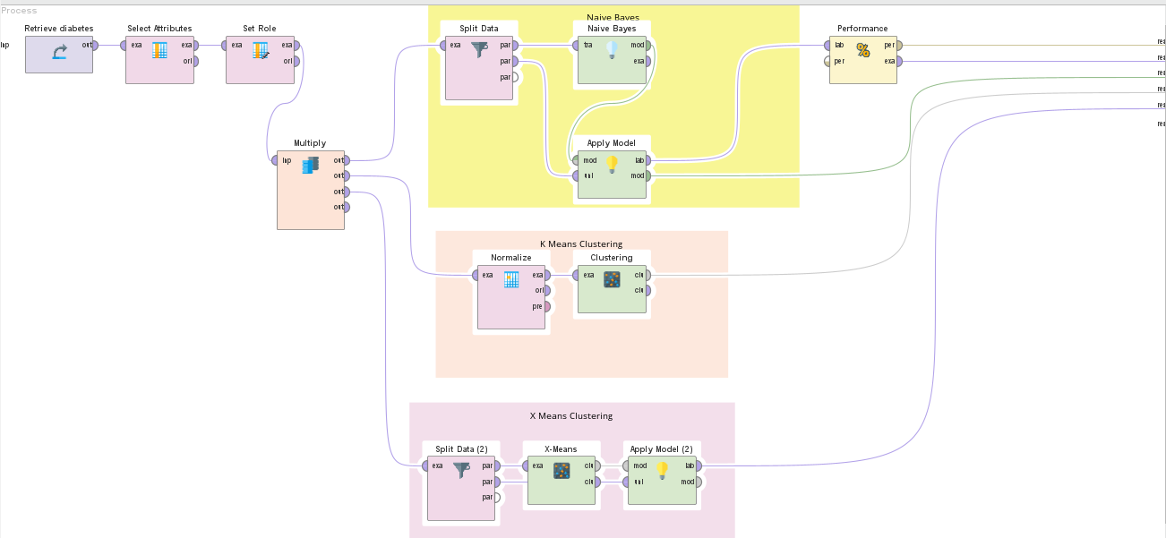

Slide 7

3. Conclusions
What does it mean?

Slide 8
Prediction Accuracy: The proportion of correctly predicted diabetes cases versus actual cases.
Sensitivity (Recall): The model's ability to correctly identify true positive cases of diabetes.
Specificity: The model's ability to correctly identify true negative cases, indicating non-diabetic individuals.
Precision: The proportion of true positive predictions among all positive predictions made by the model.
F1 Score: The harmonic mean of precision and recall, providing a single metric for model performance.
Confusion Matrix: A detailed breakdown of true positives, true negatives, false positives, and false negatives.
ROC Curve and AUC: Visualization of the model's performance across different threshold values, with the Area Under the Curve indicating overall performance.

Slide 9

Questions?

Slide 10


